Slide 1
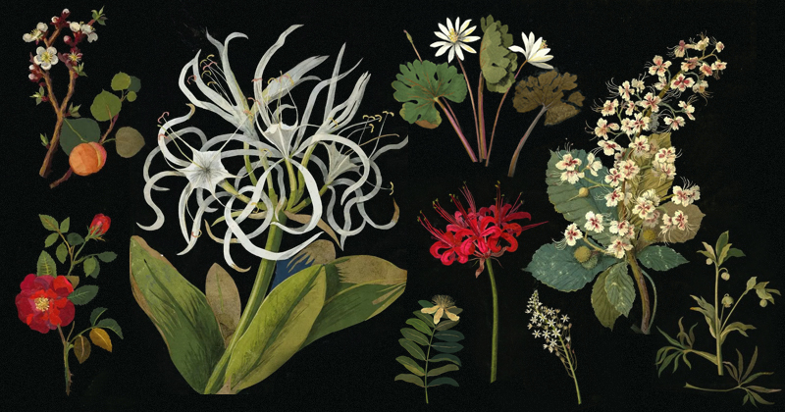
WILD PLANT INTENSIVE : LINDSAY HUETTMAN
Plant Evolution 101: WPI

Slide 2
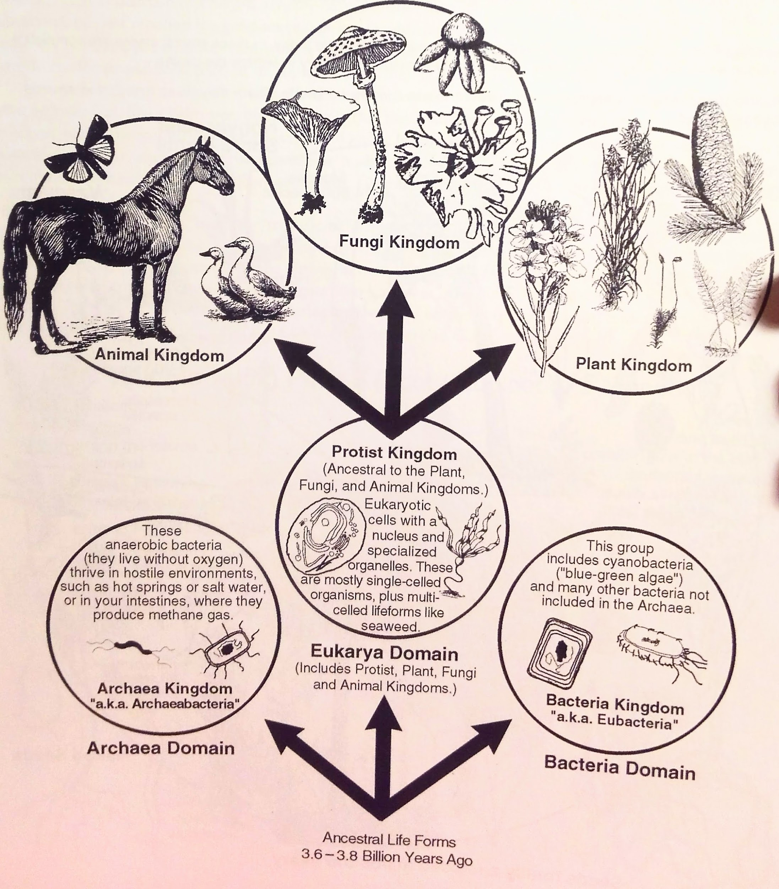
3 Domains:
Archea
Eukaraya
Bacteria
6 Kingdoms:
Animal
Fungi
Protist
Bacteria
Acrchea

Slide 3
CYNOBACTERIA-BACTERIA THAT PHOTOSYNTHESIZE

Slide 5
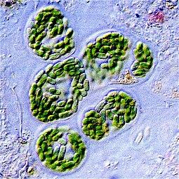
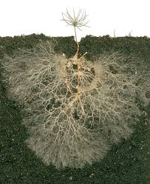
WHERE DID PLANTS COME FROM?
Cyanobacteria: Bacteria that contained blue/green algae (2.7 billion years ago)
Protoplants came up on to land and formed symbiotic relationship with fungi
(470 m.y.a) because they could offer digest forms of rock and minerals; the algae provided glucose (sugar).
90% of plants have fungal associations via mycorrhizae with plants

Slide 6
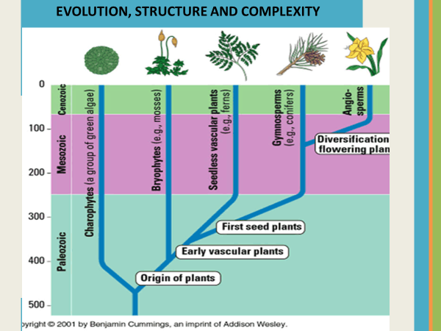

Slide 7
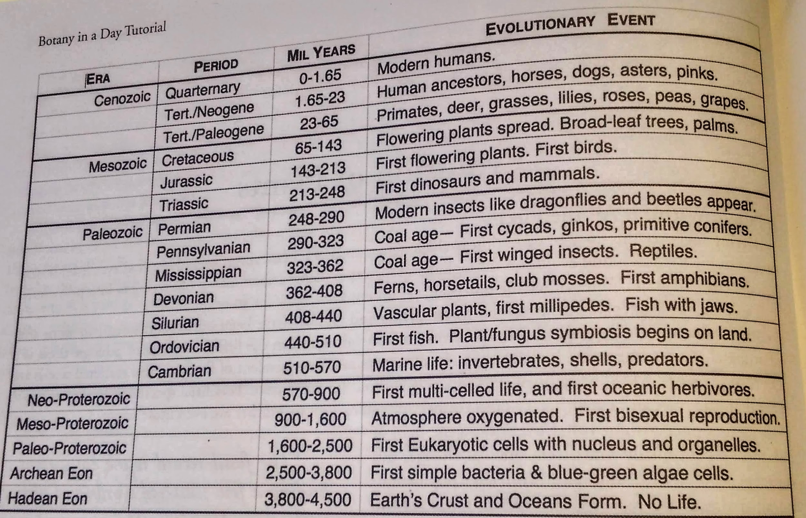
EVOLUTION, STRUCTURE AND COMPLEXITY (Elpel)
Notes:
Humans came around 300,000 years ago Homo sapiens

Slide 8
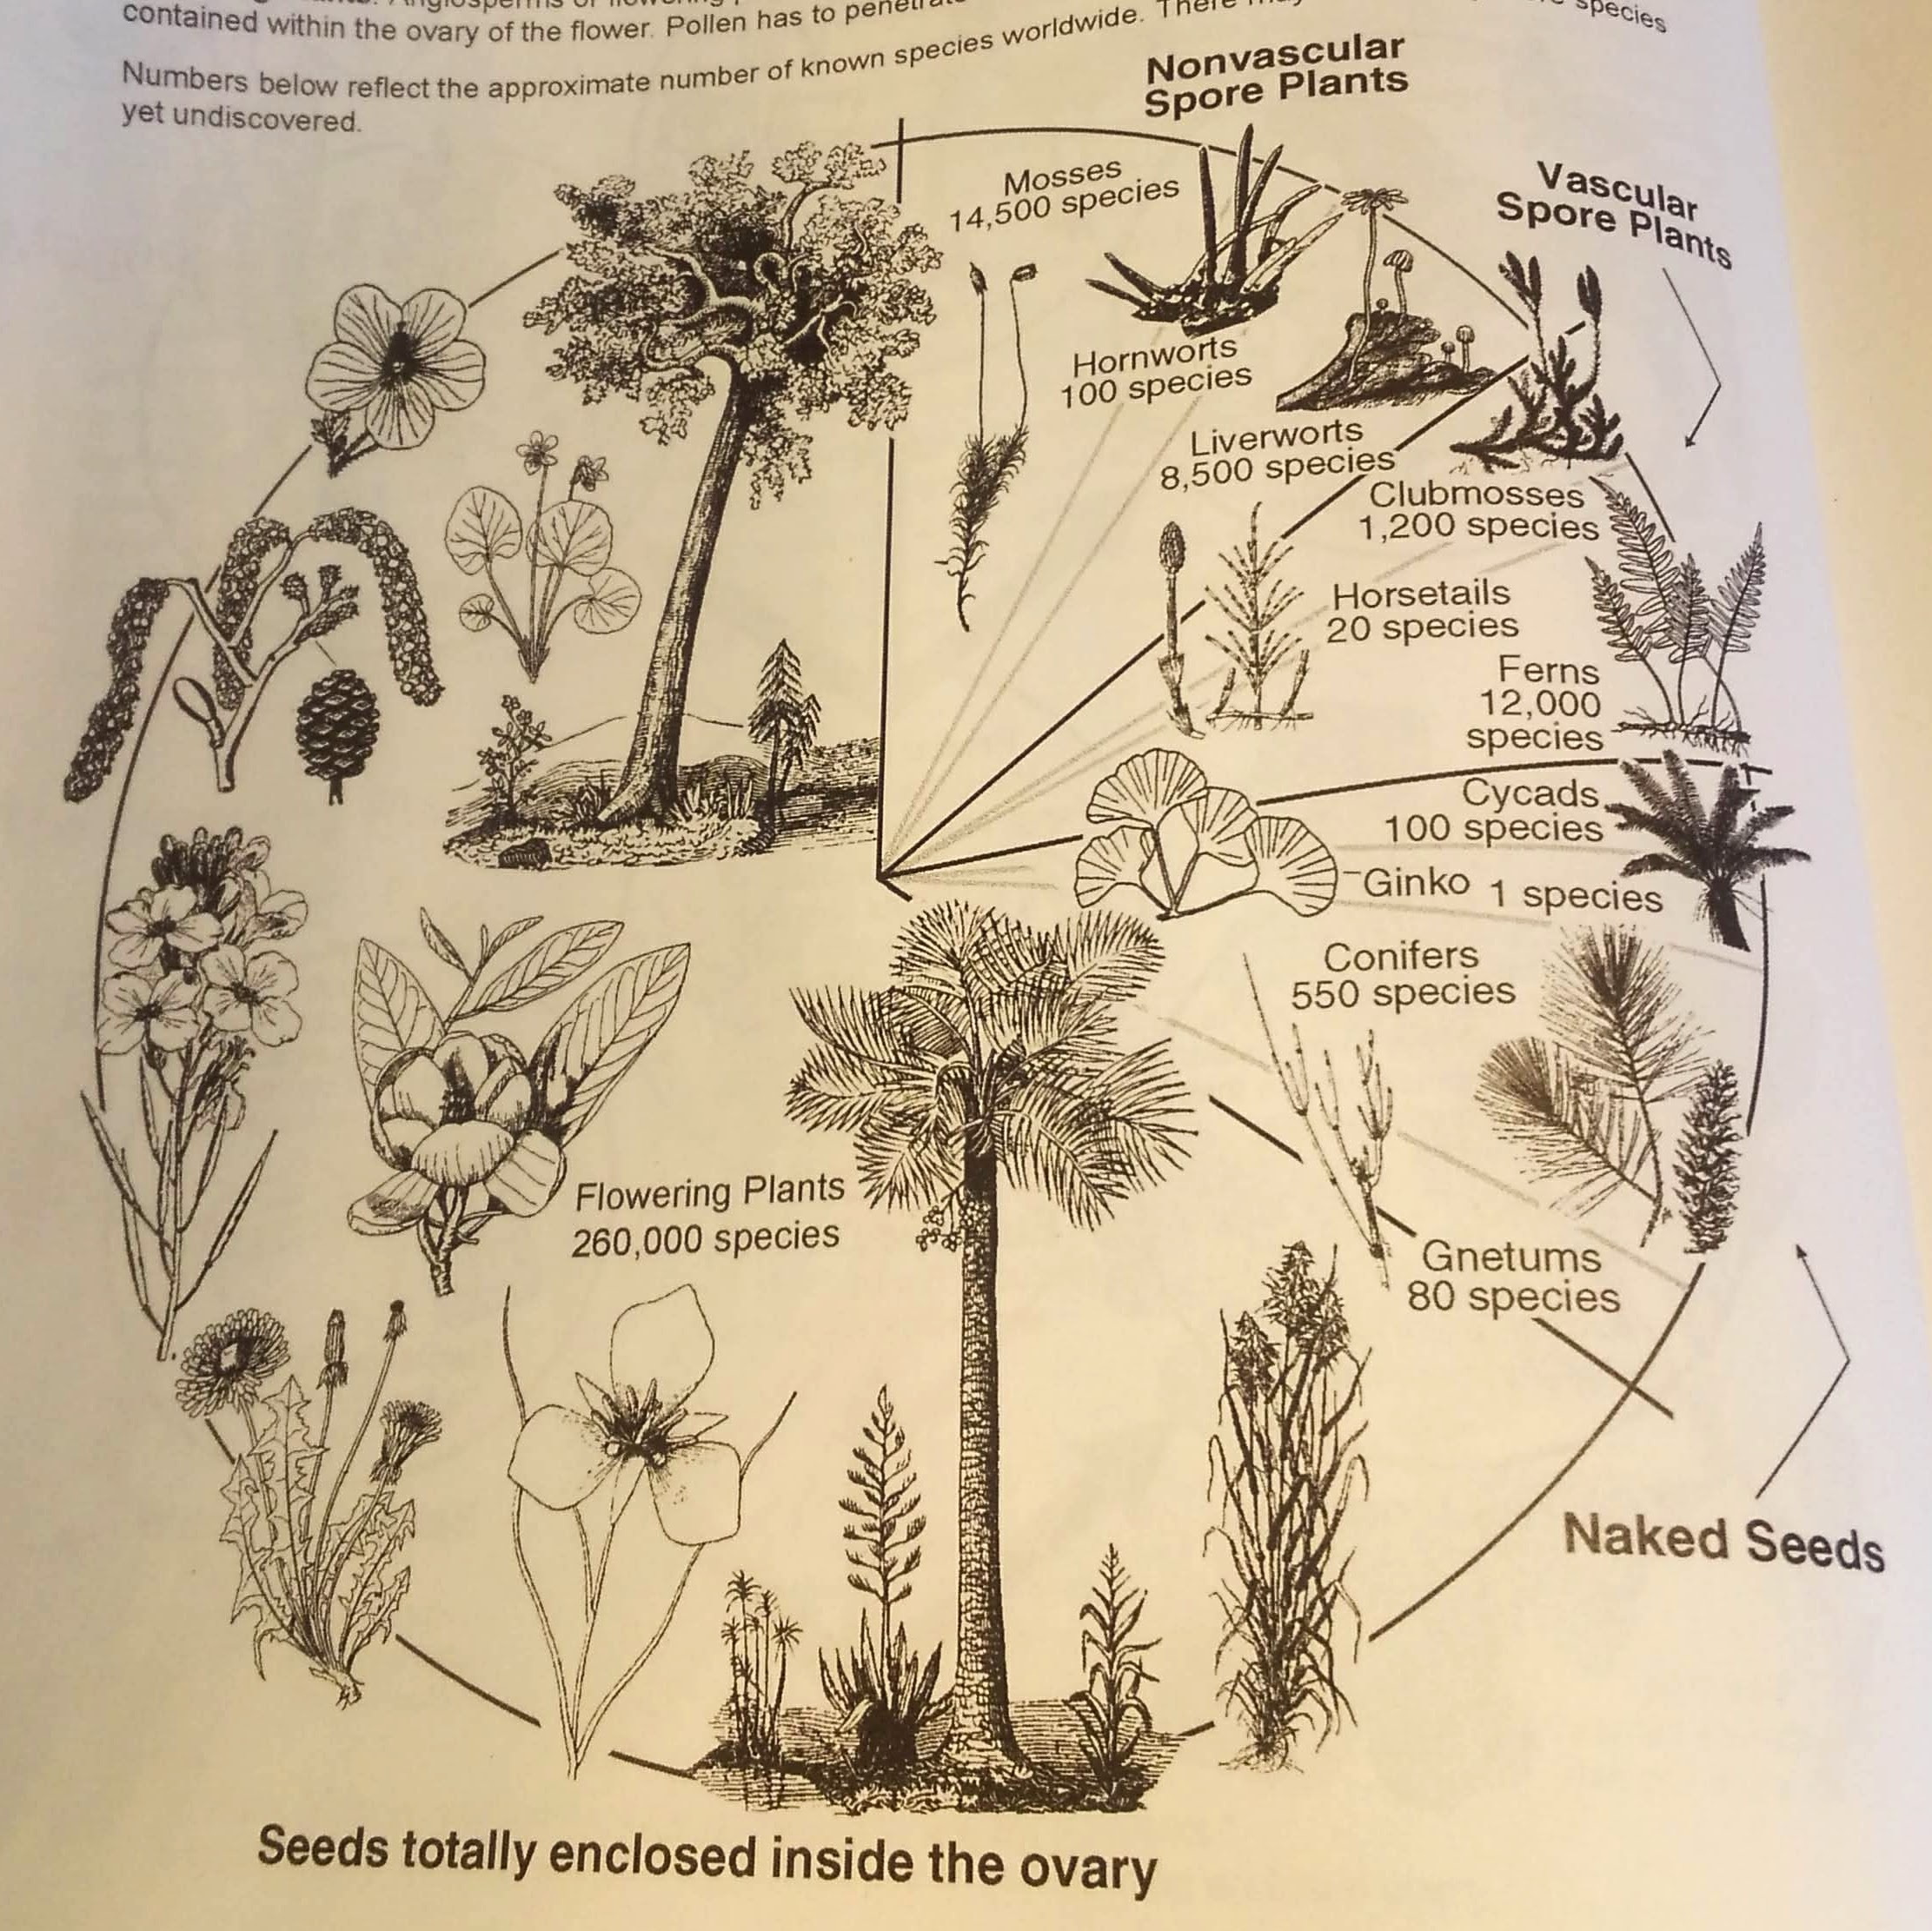

Slide 9
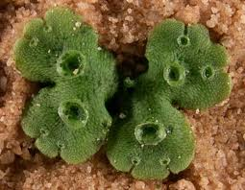
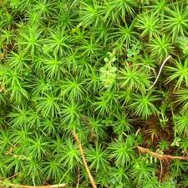
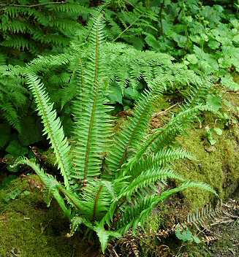
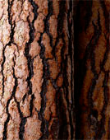
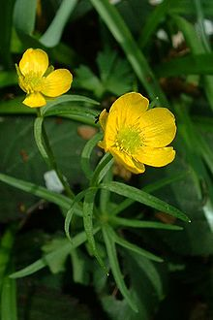
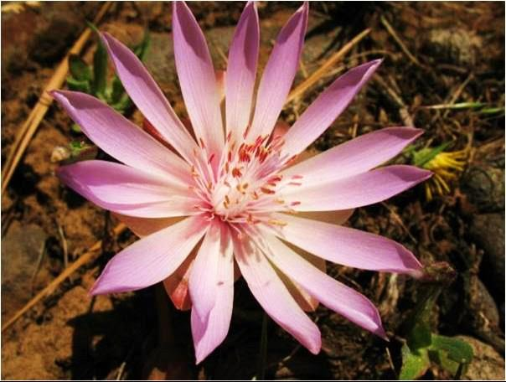
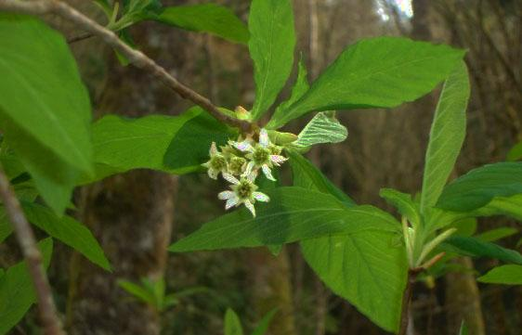
5 Divisions we are working with….
MOSSES, LIVERWORTS, HORNWORTS
(Bryophyta)
ALGAE
(Thallophyta)
FERNS
(Pterophyta)
GYMNOSPERMS (CONIFERS)
ANGIOSPERMSS-Flowering Plants

Slide 10
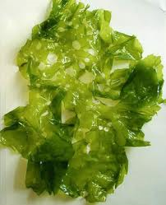
ALGAE
NON VASCULAR: Lack true roots or stems and structures for transporting water
ANCESTORS OF ALL PLANTS!
STRUCTURALLY SIMPLE
NEEDS TO BE AROUND OR IN H20 for REPRODUCTIVE CYCLES
EXAMPLES: SEAWEED,BLUE GREEN SLIME

Slide 11
Mosses, Liverworts & Hornworts
NON VASCULAR
REPRODUCE THROUGH SPORES- GEMMAE CUP….SO COOL!!
HAVE A BIT MORE STRUCTURE THAN ALGAE>>>>>>>>LESS DEPENDANT ON H20
CHLOROPHYLL HANGS OUT WHEN ITS DRY
Lots here in the rainforest!

Slide 12
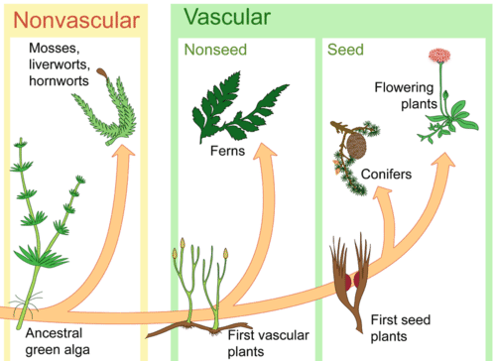
First Vascular Plants: Means they have water (Xylem) and nutrient (Phloem) conducting tissues!

Slide 13
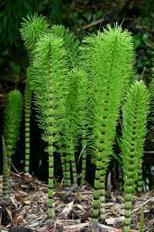
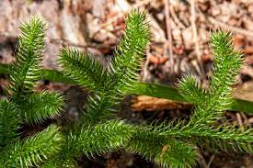
FERNS AND ALLIES (CLUBMOSSES,HORSETAILS)
Vascular systems!
Allows more specialization of structure so we get……………..
ROOTS!
BARK!!
LEAVES!!!
BRANCHES!!!!
Allows plants to stand upright & utilize
sunlight
STILL USE SPORES FOR REPRODUCTION
STILL DEPENDENT ON H2O FOR SPORES TO GERMINATE

Slide 14
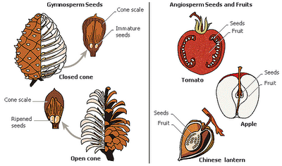
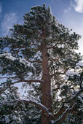
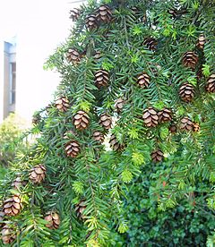
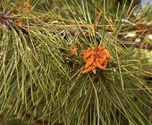
GYMNOSPERMS-CONIFERS
VASCULAR
NAKED = “GYMNO” +
SEED= “SPERM”
CONES WITH SEEDS!
WIND POLLINATED (brrrr….naked!)
CONIFERS!

Slide 16
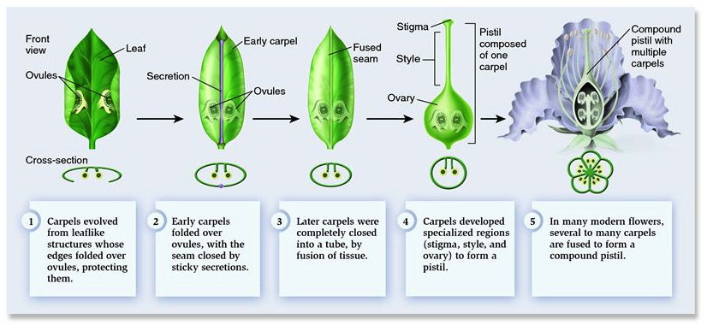
https://newcaledoniaplants.files.wordpress.com/2013/10/carpel-evo.jpg

Slide 17
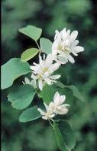
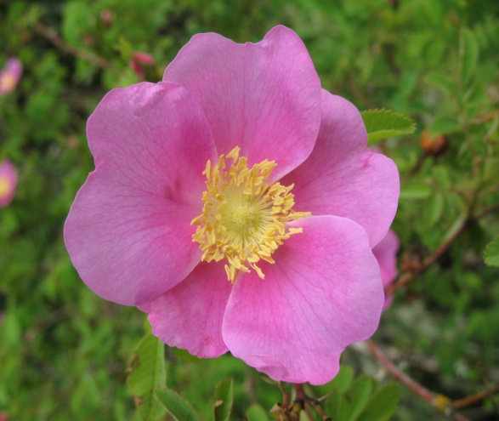
VASCULAR
“ANGIO”= COVERED
“SPERM”=SEED
(Ginko story)
FLOWERS AND THEIR STRUCTURES!
-Petals!
-Pollinators
-Fruit
ANGIOSPERM-FLOWERING PLANTS

