Slide 1
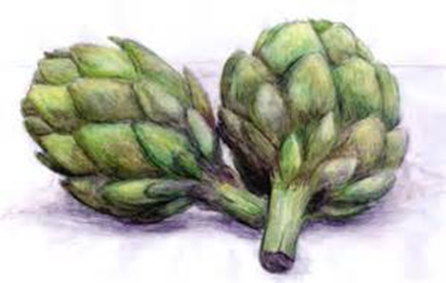
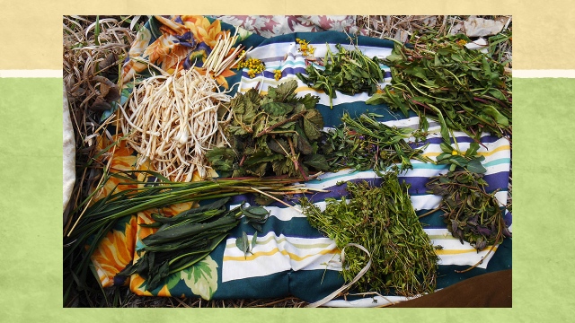
Plant Nutrition: Wild and Domestic
Lindsay L. Huettman
Lady Botanica/Wilderness Awareness School

Slide 2
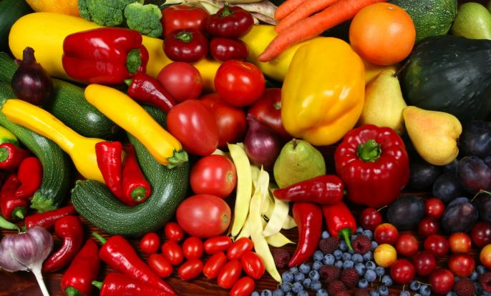
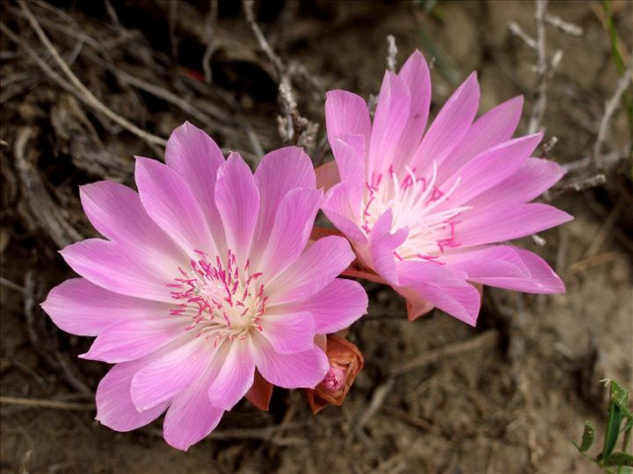
Aren't plants colorful???

Slide 3
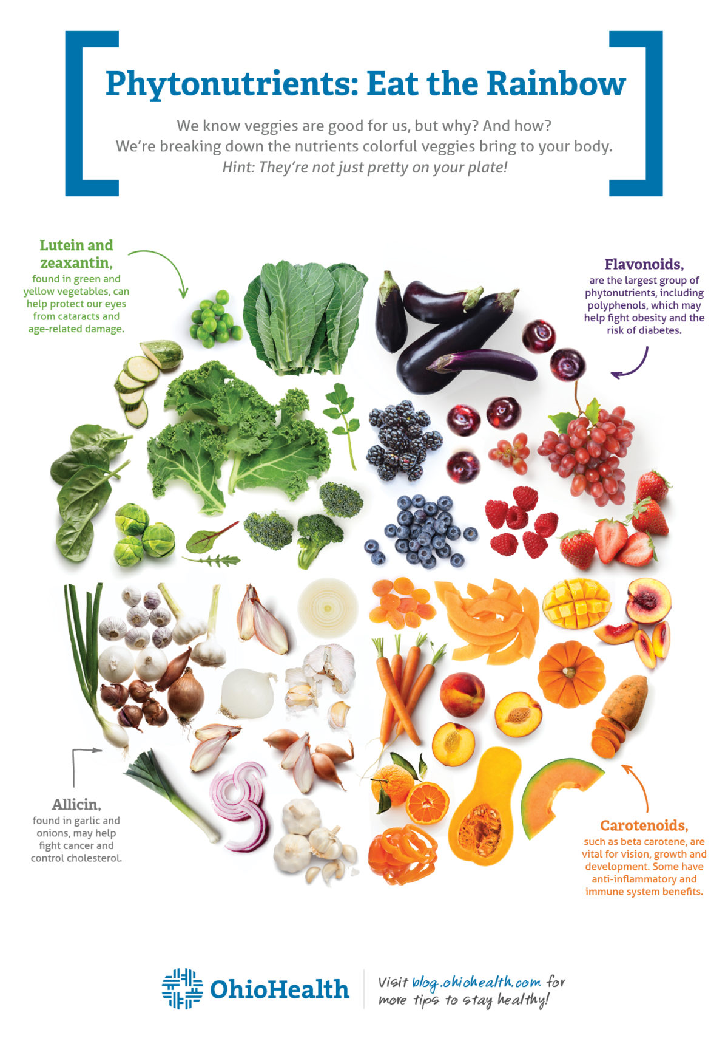

Slide 4
Why are they so colorful ?
Secondary Metabolites:
Not use in primary processes……

Slide 5
Secondary Metabolites:
POLYPHENOLS
Protect against UV damage
Deter predators and fight pathogens
Attract pollinators (flavonoids, carotenoids, betadines)
Slow down oxidation of plant tissues
Many are located in the skins (epidermal layers) and petals of many plants…

Slide 6
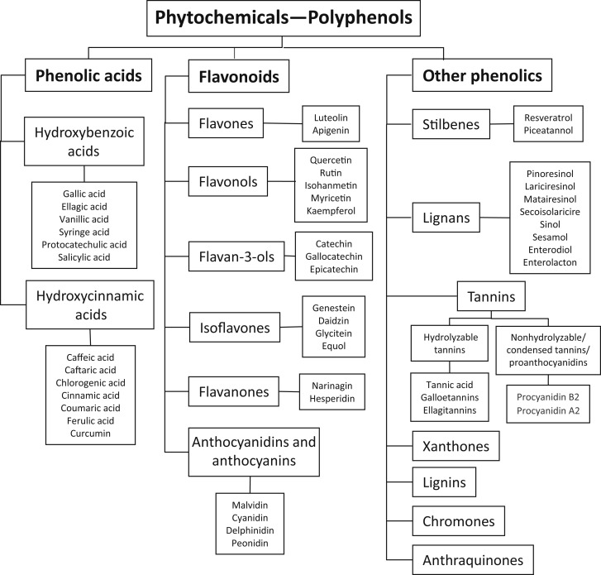

Slide 7
What are phytonutrients?
There are SOOOO many names here that mean the same thing!!
“PHYTON”…means plant + “NUTRIENTS”=phytonurtients
Phytochemicals/Phytonutrients/Phytochemicals=Polyphenols
* There are over 8,000 identified polyphenols found in foods such as tea, wine, chocolates, fruits, vegetables, and extra virgin olive oil,1 just to name a few.
*There have been 30,000 studies published on phytonutrients since 2000.
*Jo Robinson, “Eating on the Wild Side”

Slide 8
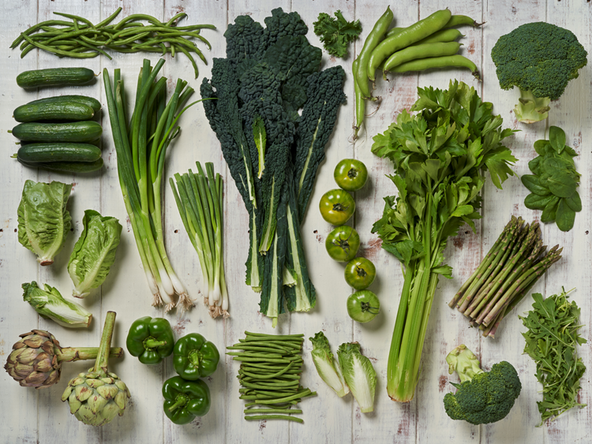
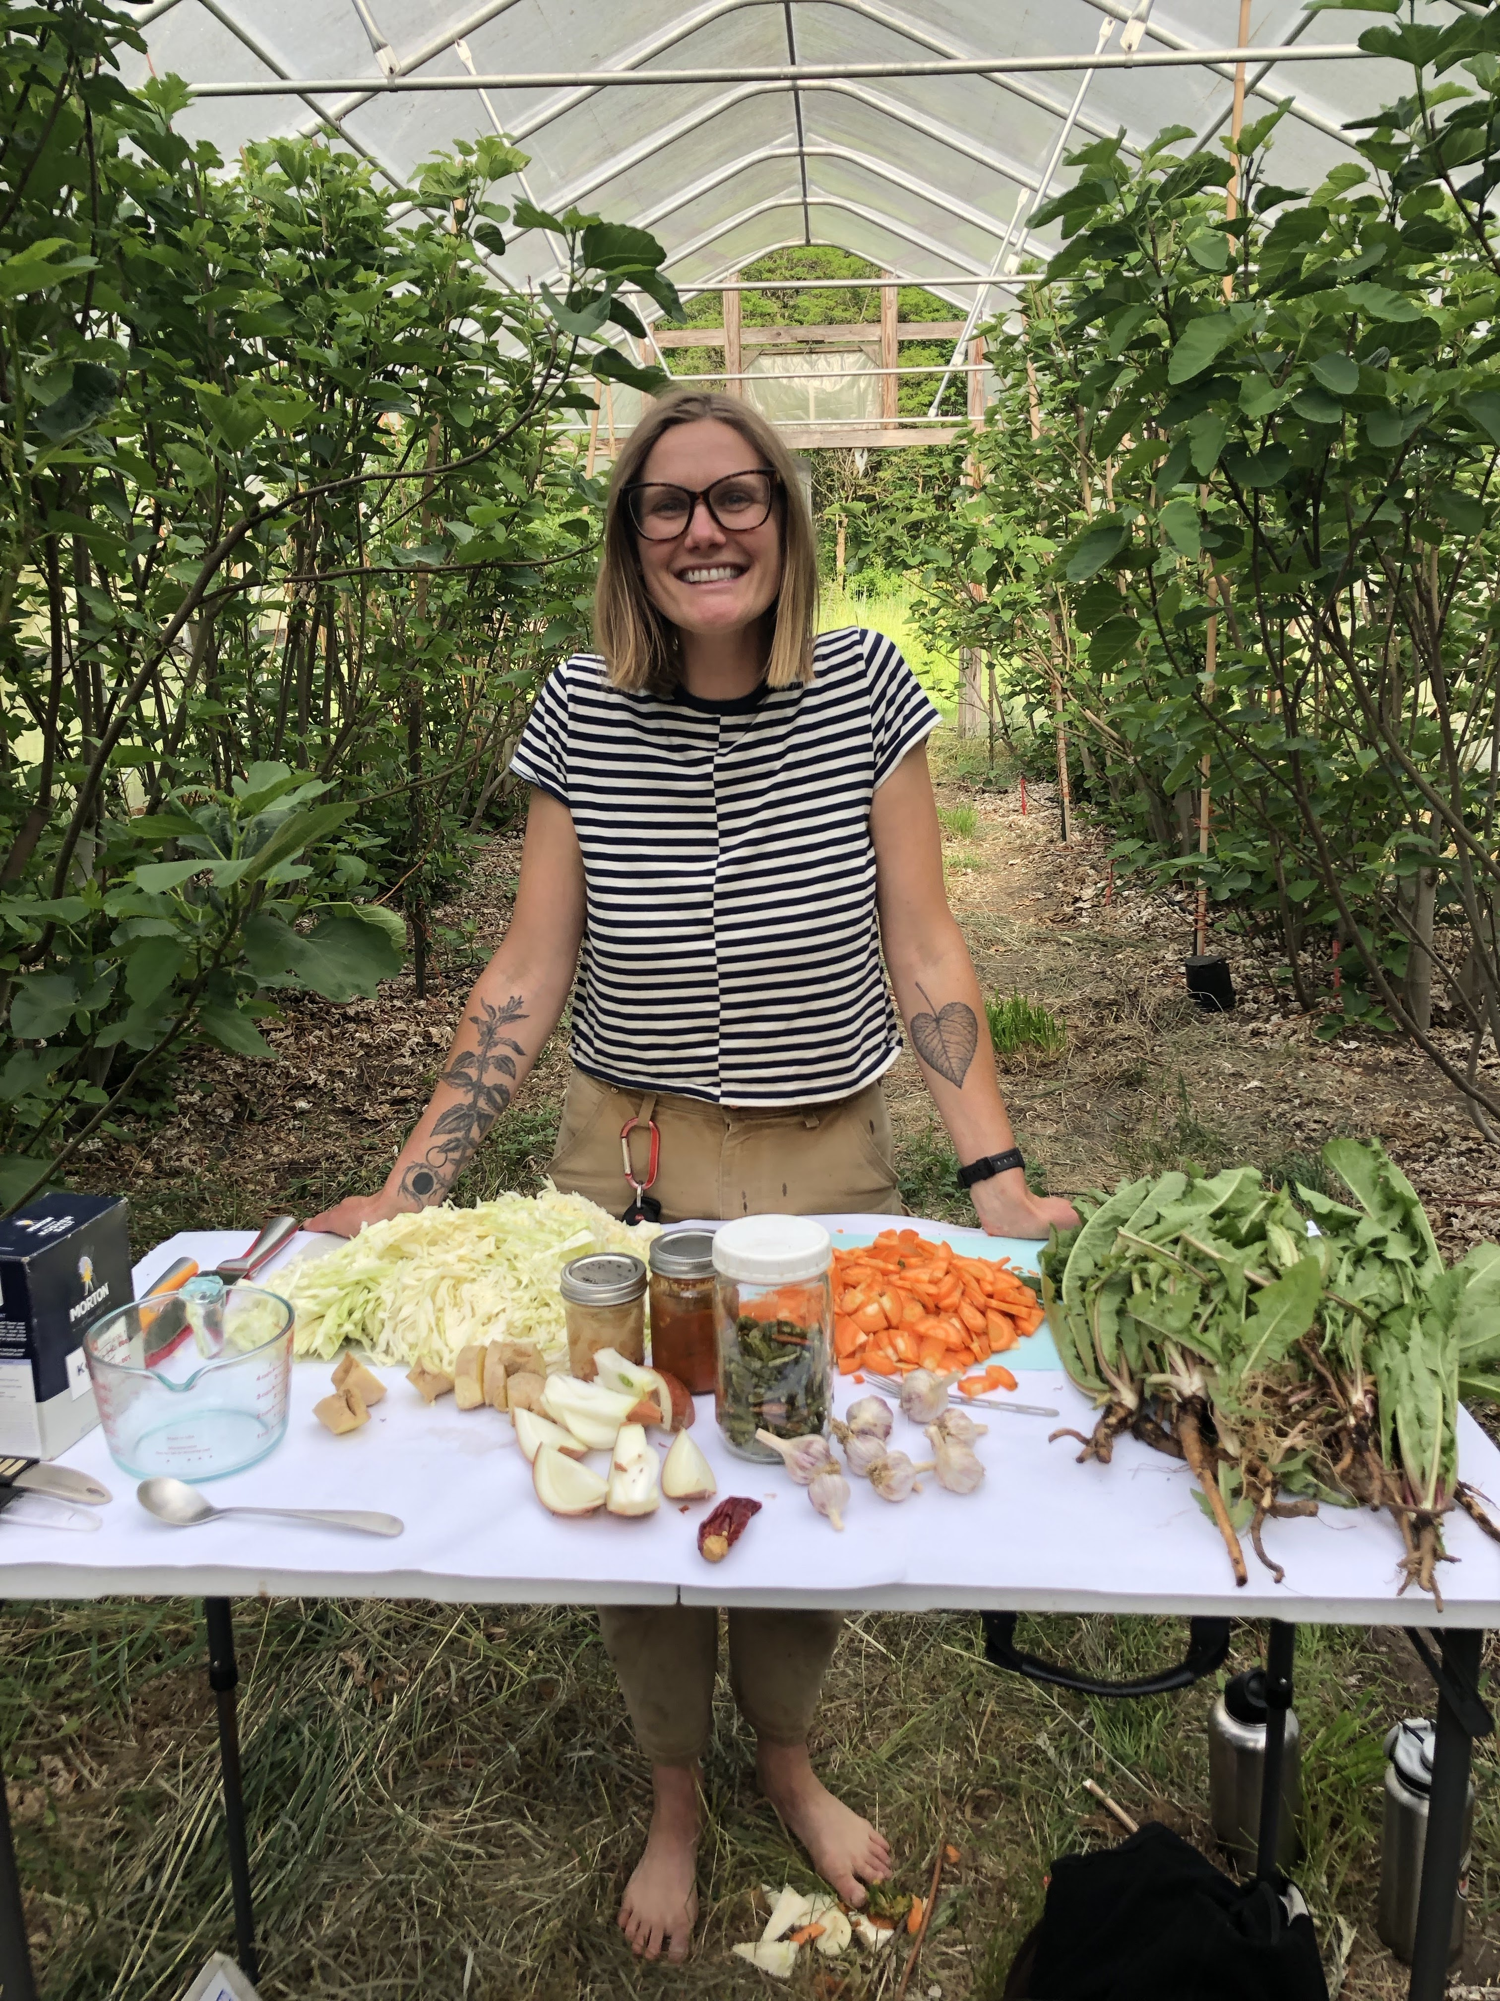
Plant Food as Medicine

Slide 9
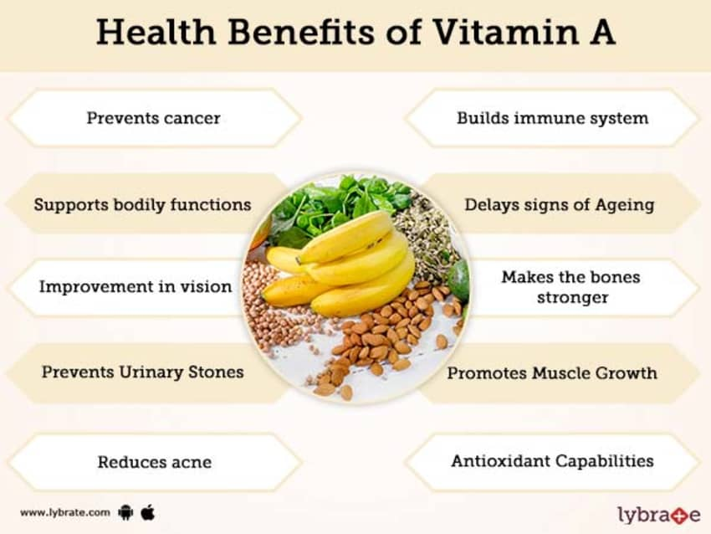

Slide 10
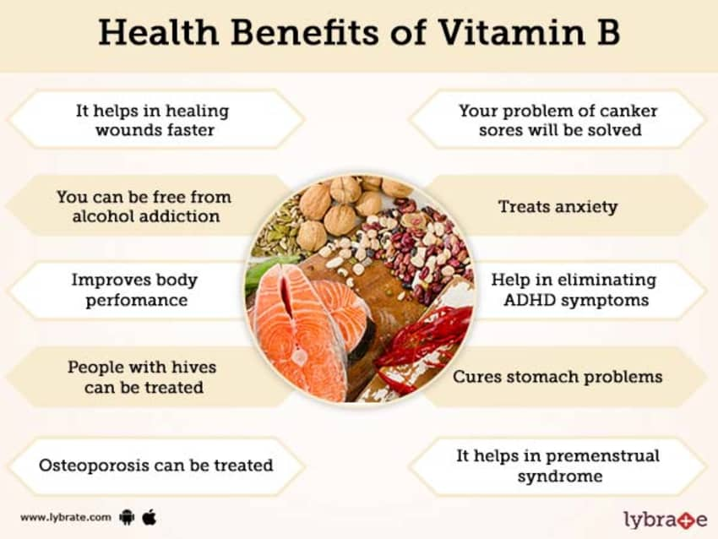

Slide 11
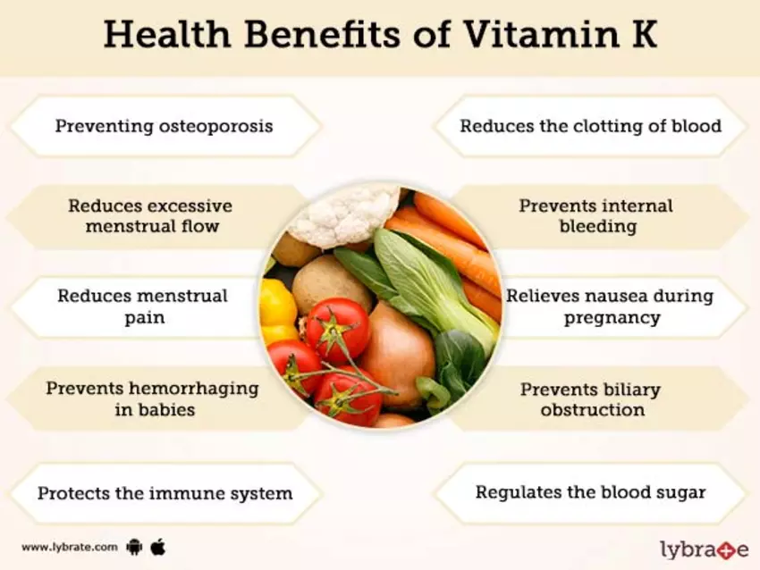

Slide 13
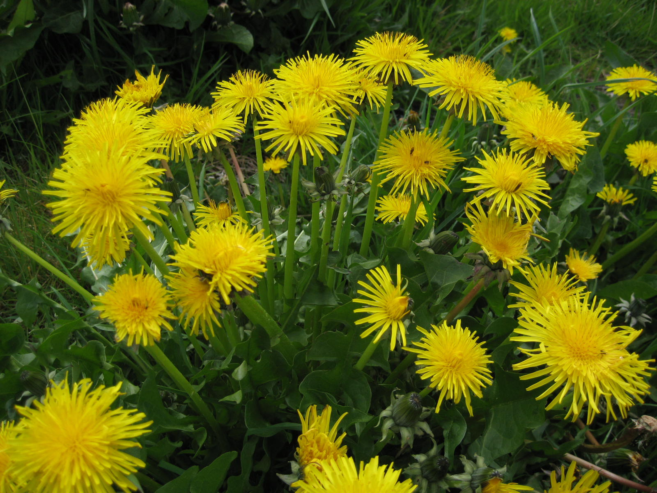
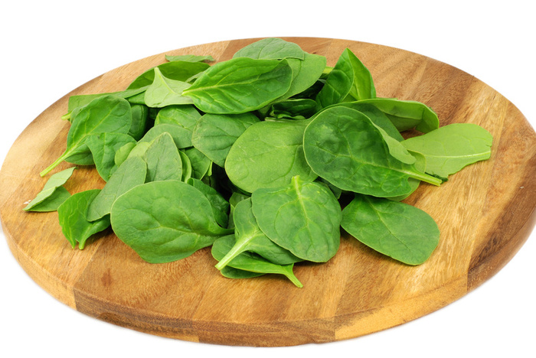
PHYTONUTRIENTS AND WILD PLANTS
More phytonutrients in wild or naturalized plant
Polyphenols have not been bred out of them: they still need to defend themselves
Example: Dandelions vs. Spinach

Slide 14
DANDELIONS VS. SPINACH
DANDELIONS HAVE…..
8 TIMES MORE ANTIOXIDANTS
2 TIMES MORE CALCIUM
3 TIMES MORE VITAMIN A
5 TIMES MORE VITAMIN K
5 TIMES MORE VITAMIN E
But can we only eat wild plants? (Discuss)

Slide 15
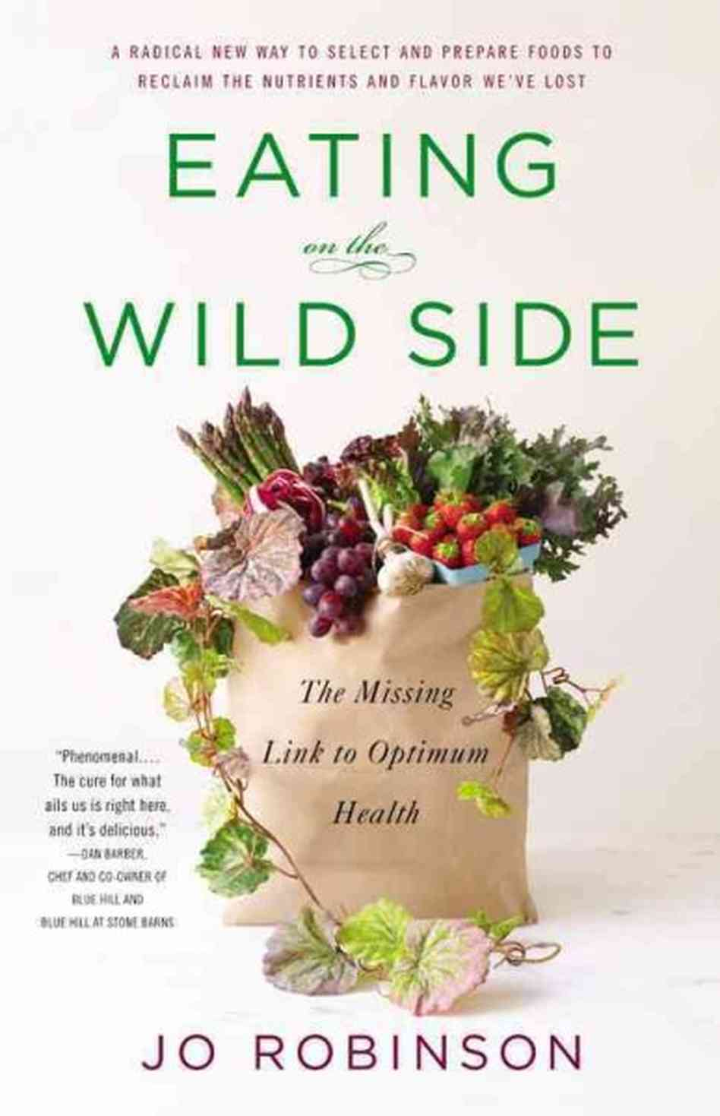
Meet Jo Robinson: Eating on the Wild Side

Slide 16
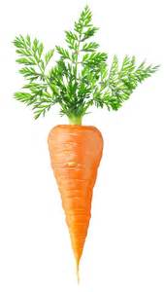
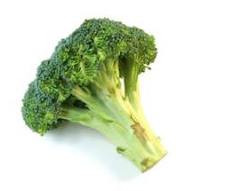
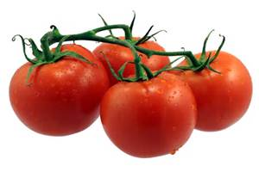
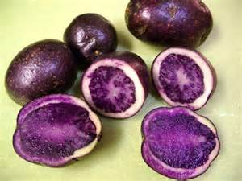
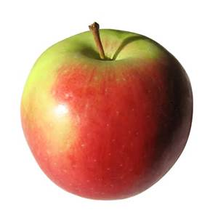
Domestic cultivars: Where did they come from?
Corn: Mexico
Potatoes and Tomatoes: South American Andes
Carrots: Afghanistan
Brassicas: Mediterranean
Artichokes: North Africa
Apples: Kazakhstan

Slide 17
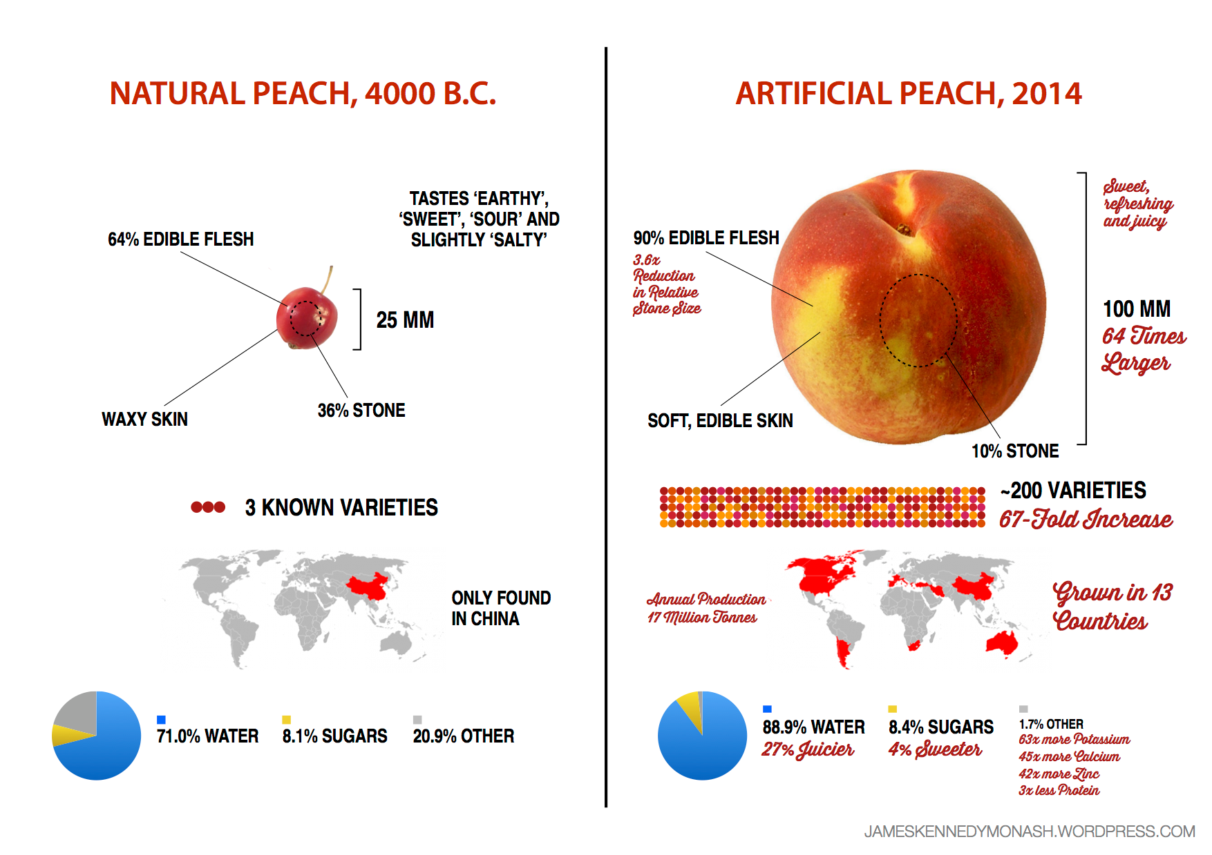
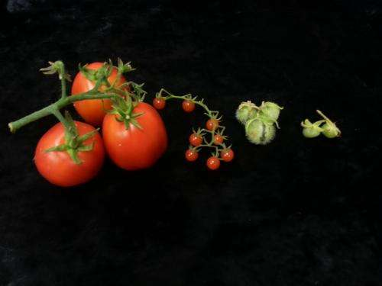
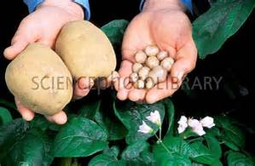
Why are phytonutrients they more adundant in wild plants?

Slide 18
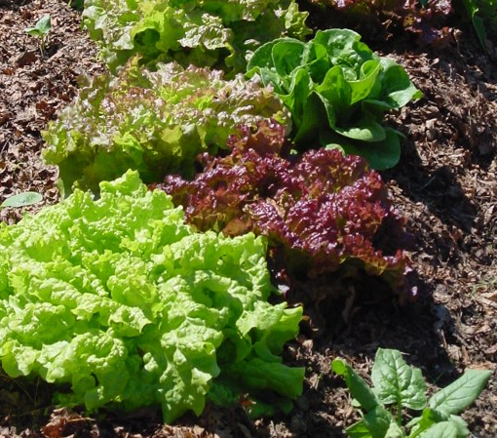
So is it just the right food or how I prepare it?
BOTH!!!!
Pick colorful varieties of wild AND domestic crops
Eat skins
Know how to prepare:
Carrots/Bitteroot: More nutritious when they are cooked
Lettuce/Wild Greens: Cut it up the night before you eat it: more defense phytonutrients are created and grow/purchase open leaf varieties: UV DEFENSE
Tomatoes: processed tomatoes have MORE lycopene than fresh
Garlic: cut and LEAVE for 10 minutes before you cook it (wont destroy anti-cancer, oxidant,clotting and bacterial properties)
Some advice from Dr. Michael Greger, cooking and phytonutrients.

Slide 19
FOOD as Medicine: Wild and Domestic
How do we start to pick what we need?
1. Acute vs. Preventative
Lindsay in Montana -Anemia=Low Iron (FE)
What wild (and domestic foods) are high in iron?
-Nettles, Lambsquarters, Beaked Hazelnuts, Nuts, Beans and Spinach
2. Do your own research on medicinal/nutritive benefits
-Scientific Journal Articles, Lectures, Textbooks and biochemical research
-FDA Plant Profiles and nutrition websites backed by scientific evidence
-Ethnobotanical Research without APPROPRIATION
-Books like Eating on the Wild Side, Native American Recipes, Botany of Desire
-Listen to your elders

Slide 20
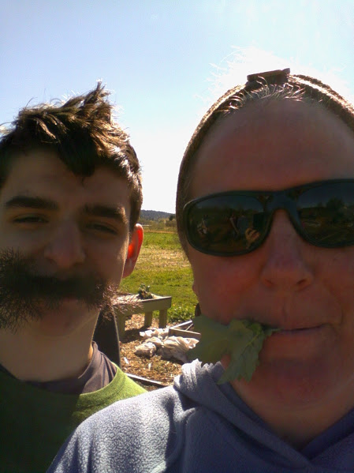
FOOD as Medicine: Wild and Domestic continued…
3. Use cooking methods described for domestic foods (prior video) to inform how to prepare wild food.
-Is this wild plant an ancestor of a domestic variety?
-Don’t over or under prepare: denaturing vs. non accessible
-Look for indigenous recipes if you can
4. MIX domestic and WILD varieties
-It can make more unpalatable wild species more edible
-Re training your tongue slowly!
-Have fun and share with us what you have created!

Slide 21
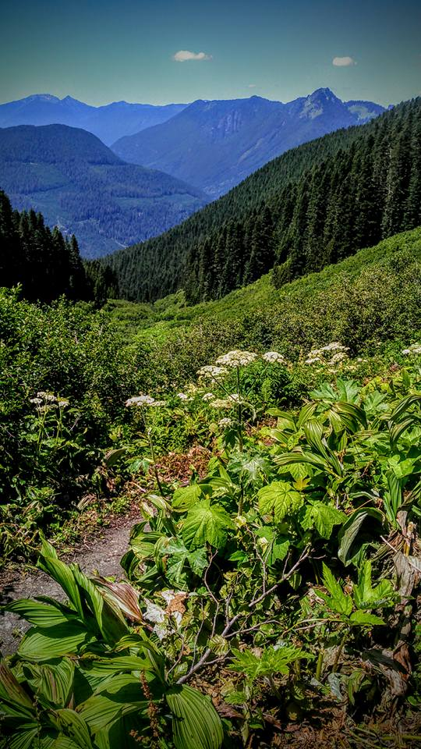
What are foods are from your culture and ancestors prepared?
https://salishseasentinel.ca/2015/10/powerful-knowledge-shared/

Slide 22
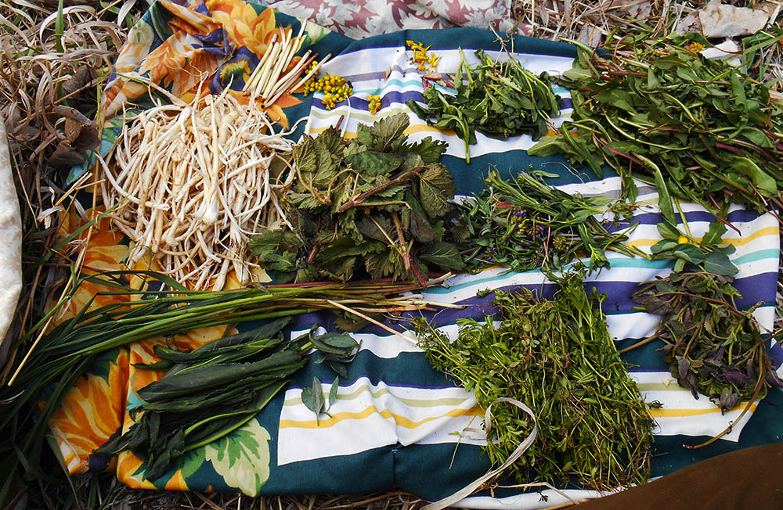
THE END

